Slide 1
Frome Gateway Regeneration Framework
A community conversation
17th & 19th February 2022

Slide 2
Housekeeping

Slide 3
Structure of today's session
3.00 - 3.15: Arrival and refreshments
3.15 - 3.30: Introduction and context
3.30 - 5.00: Interactive exercises (30 minutes each)
Scope of influence
Assest mapping
Opportunities and constraints mapping
5.00 - 5.30: Frome Gateway Story of Place presentation

Slide 4
Introduction and context
- What we're doing and why
- Progress to date
- Our approach to community engagement
- TRUUD Research Project
- Structure of today's engagement exercises

Slide 5
What are we doing?
We want to work with local residents, businesses, landowners and other stakeholders to create a thriving neighbourhood with:
New homes
New job opportunities
Better community and public spaces
Improved green spaces, including the River Frome

Slide 6
What are we doing?
Over the course of 2022 Bristol City Council will be producing a Regeneration Framework to guide the long-term transformation of the land either side of the River Frome in St Jude's, known as Frome Gateway, to better meet the needs of the city and the local community.

Slide 7
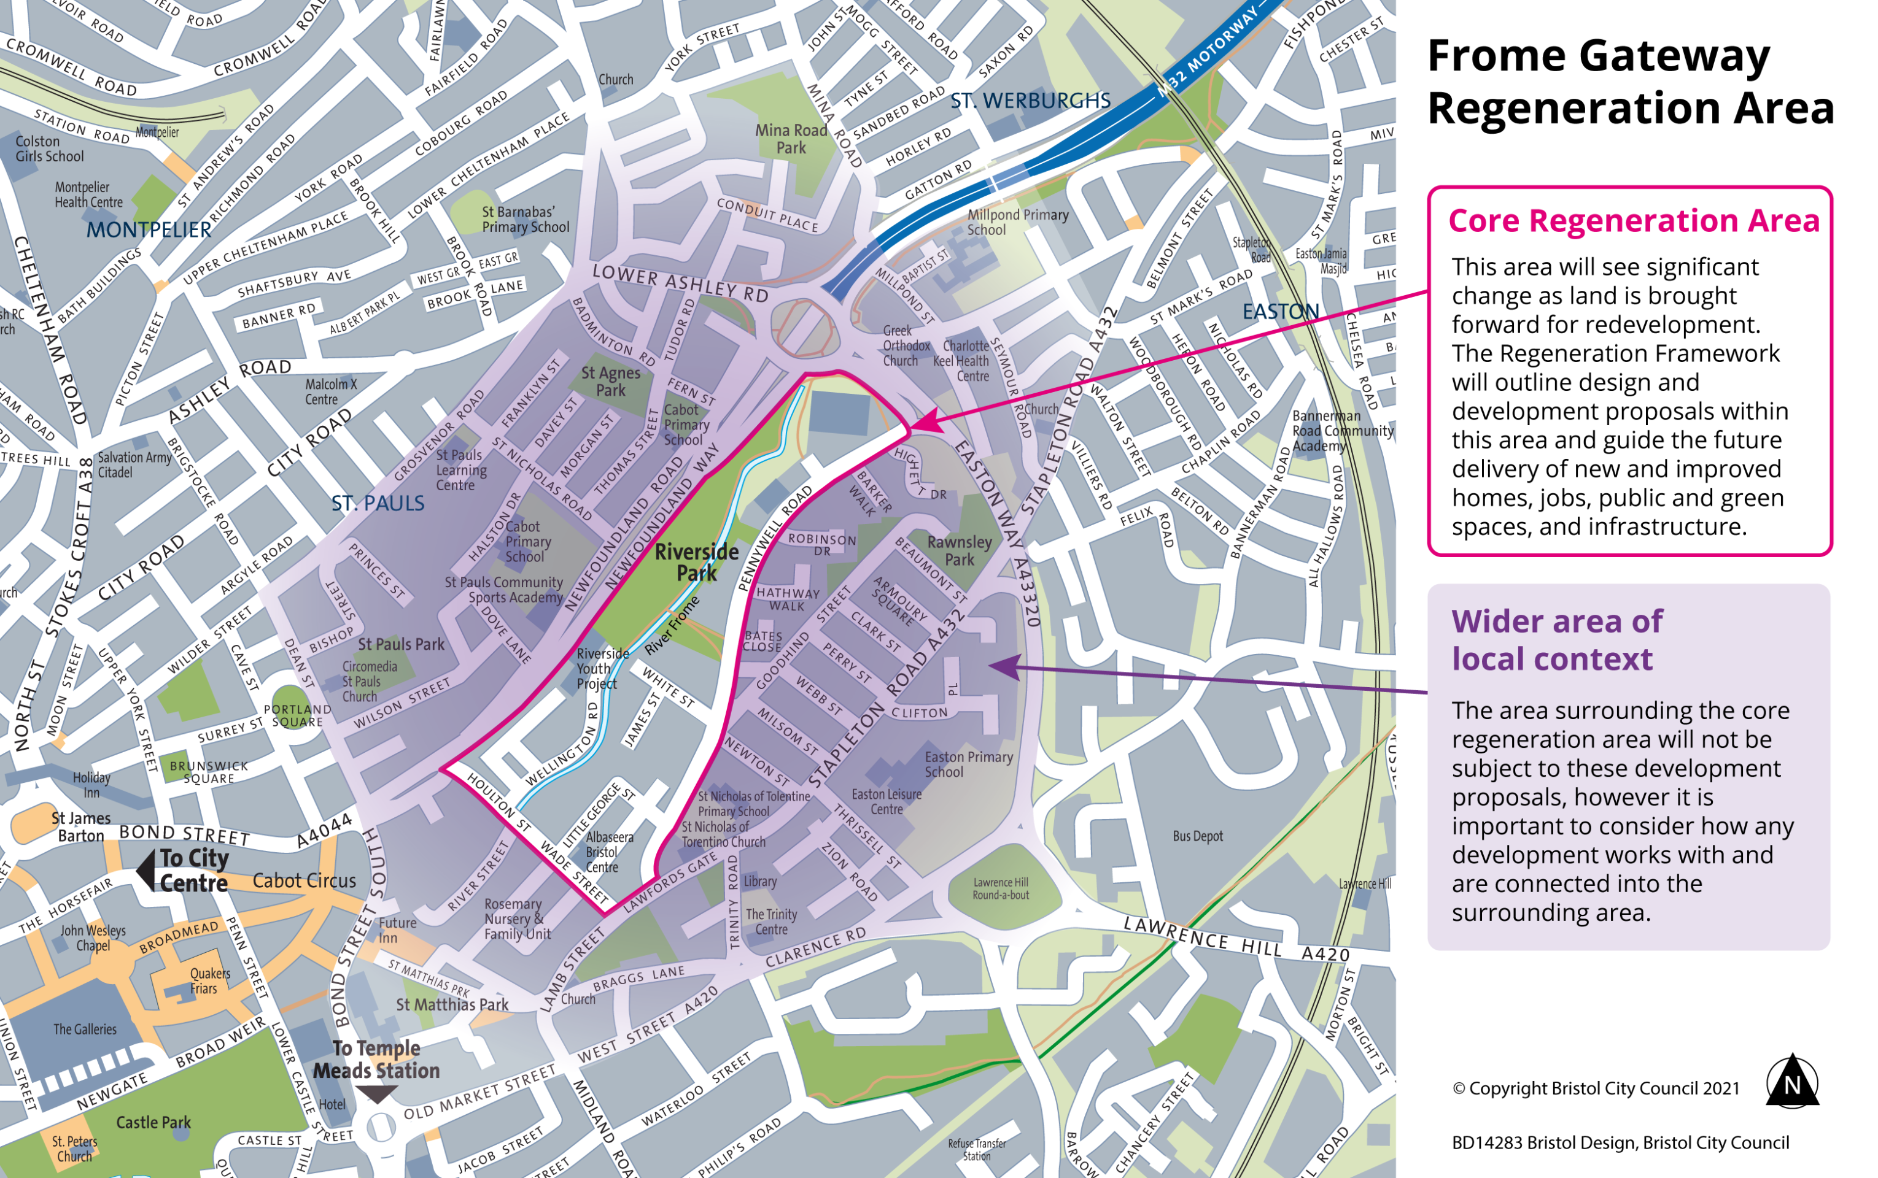
Where are we talking about?

Slide 8
What is Regeneration?
The co-ordination of public and/or private investment and resource to bring about improvements to an area's physical environment and local services to increase employment opportunities and quality of life.
Regeneration can take many forms, from community-led projects to transformative redevelopment.

Slide 9
What is a Regeneration Framework?
Regeneration Frameworks are documents which...
Bring together city planning, transport and design thinking to establish a long-term vision and strategy for change for an area.
Tend to be prepared where a lot of change is anticipated over a long period of time.
Are used to guide and determine planning applications in line with the long-term vision and regeneration objectives.

Slide 10
Why do we need a Regeneration Framework?
Regeneration Frameworks are there to make sure that...
Any changes work well together
Everyone's working towards the same long-term vision
Long-term change is coordinated across the area
Long-term change is considered more holistically
We arrive at the most appropriate, balanced and deliverable vision and strategy for change

Slide 11
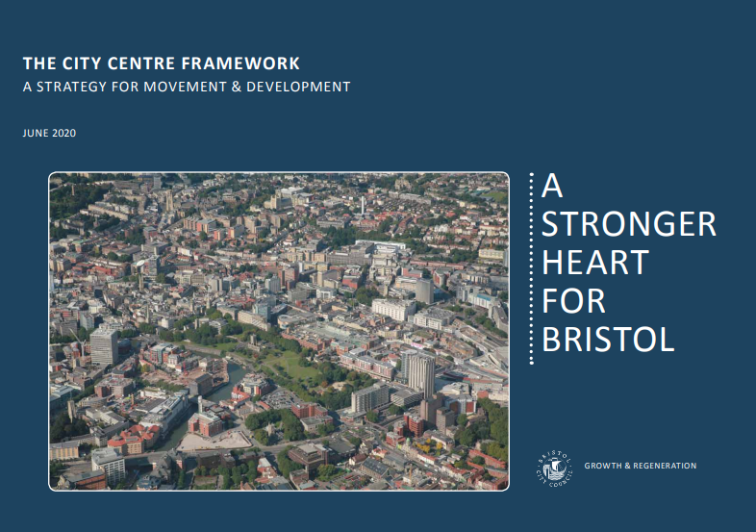
What do Regeneration Frameworks look like?

Slide 12
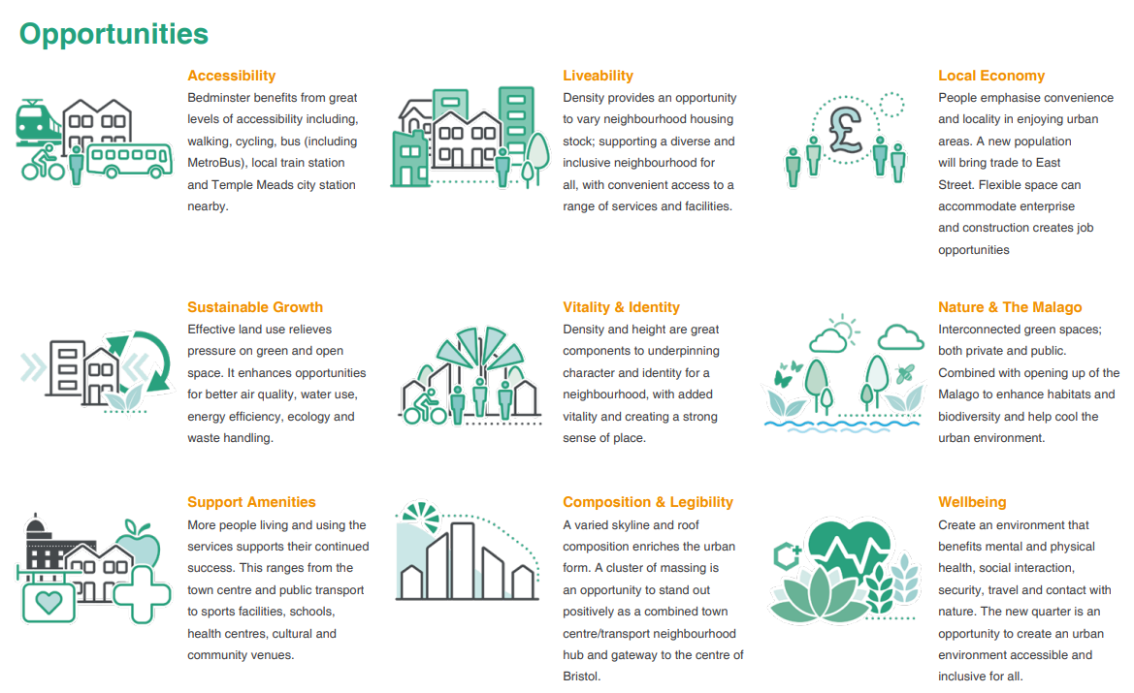
What do Regeneration Frameworks look like?

Slide 13
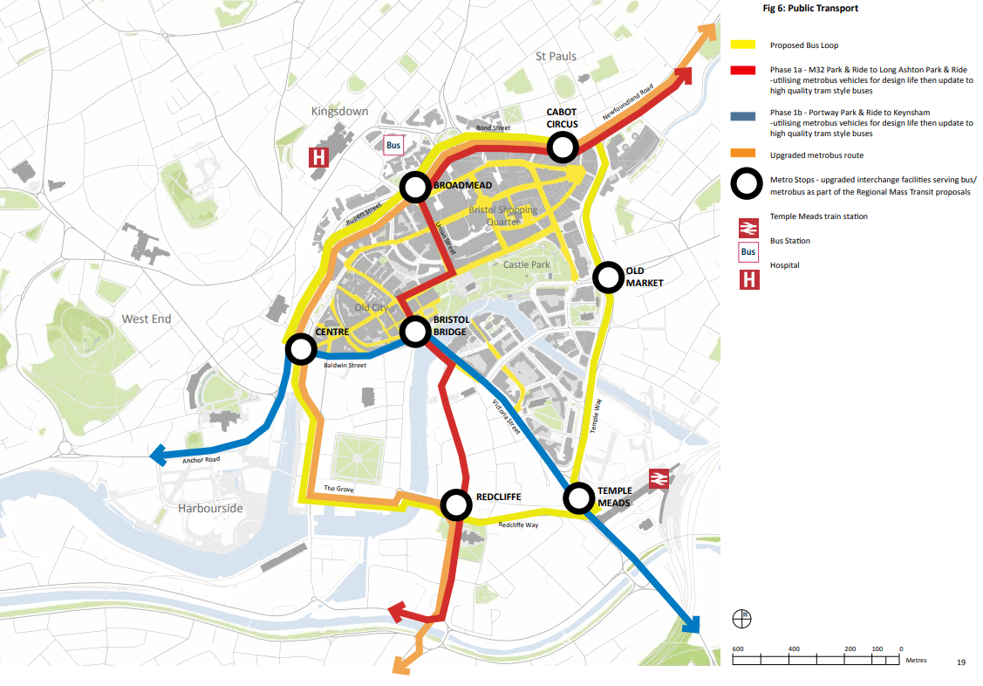
What do Regeneration Frameworks look like?

Slide 14
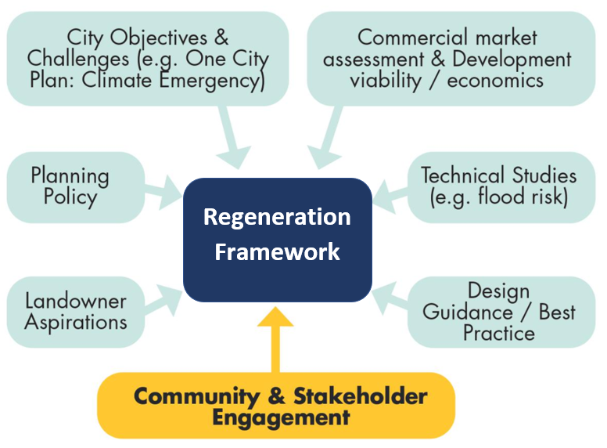
Influences on a Regeneration Framework

Slide 15
Why is all of this this needed?
The need for local investment to reduce inequality
Growing interest from the private sector to bring forward new development in this area
The housing crisis
Supporting the local and city economy
The climate and ecological emergencies
Changing planning policy

Slide 16
Progress to date

Slide 17
Progress to date
Community Place Principles (2019/20)
Frome Catchment Innovation Programme
Secured funding to develop the framework
Established dedicated project team
Prepared to re-launch following COVID-19 lockdown

Slide 18
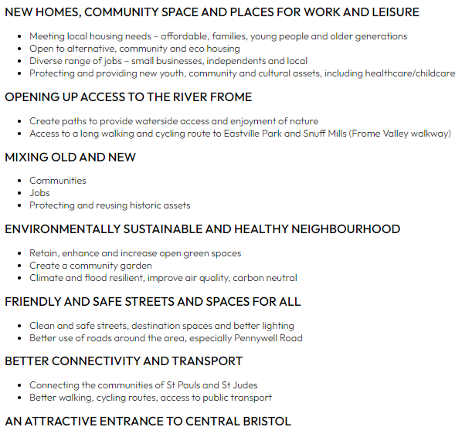
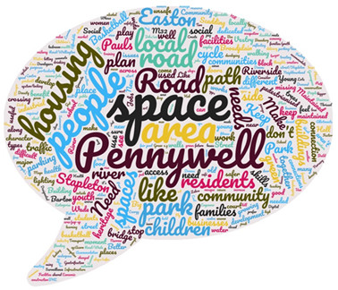
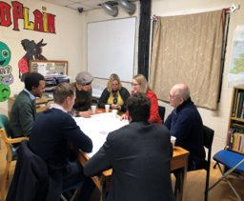
Place Principles

Slide 19
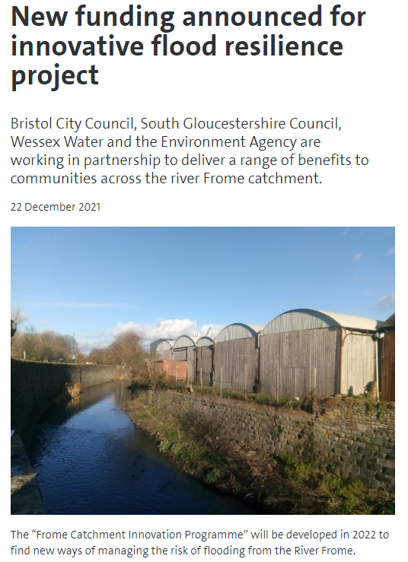
Frome Catchment Innovation Programme
Funding secured to find new ways of managing risk of flooding from the River Frome
Multiple benefits in multiple locations (whole river catchment approach)
Response to the climate and ecological emergencies
Outline Business Case to explore early proposals in development including river restoration at Frome Gateway.

Slide 20
Our approach to community engagement
- Our approach to co-design
- Stages of engagement
- Engagement programme workstreams
- Scope of Influence
- What we've done so far and what we'll do next
- How to stay informed and involved

Slide 21
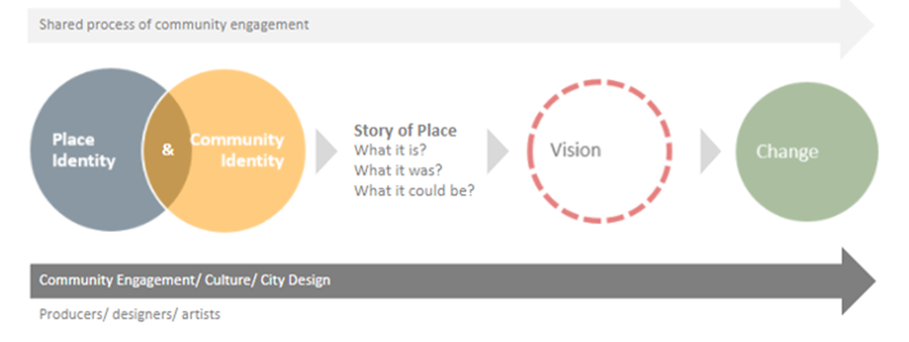
Co-design through lived experience
Lived experience
Professional expertise

Slide 22
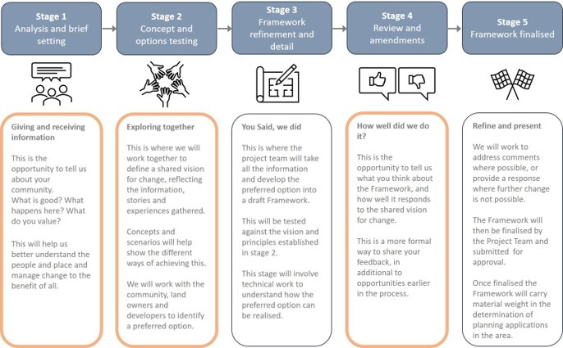
Stages of engagement
BCC Cabinet
Feb–April 2022
May–July 2022
Aug–Oct 2022
Nov–Feb 2023
March 2023
May 2023

Slide 23
Engagement programme workstreams
Community engagement
Business engagement
Landowner / developer engagement
Strategic/city partners (such as the Environment Agency, One City Office and the West of England Combined Authority).

Slide 24
Scope of Influence
Parts of the framework which the community will help to shape alongside other factors
Parts of the framework which the community will be informed about, but have little influence over
Parts of the framework which the community will be invited to develop and deliver solutions with us

Slide 25
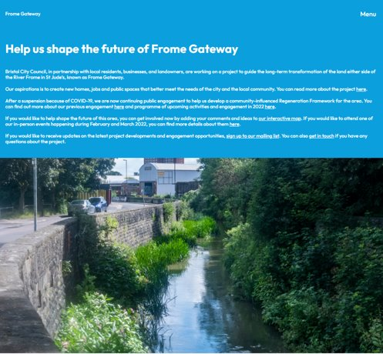
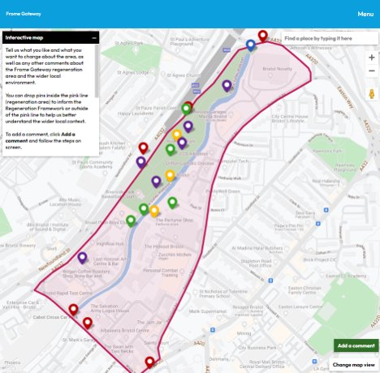
What we've done so far
Early community engagement and Place Principles
Business letter drop and online survey
Landowner / developer letter drop and online survey
Launched dedicated project website including interactive map

Slide 26
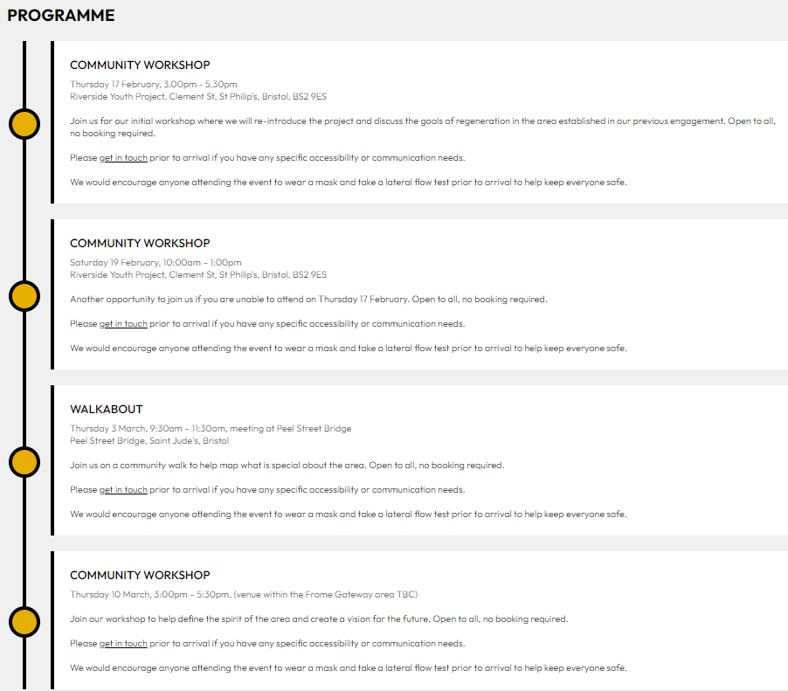
What we'll do next (Feb-March 2022)
Launch events and community workshops
1-1 business engagement
1-1 landowner / developer engagement
Take stock and prepare for stage 2 engagement (May-June 2022)

Slide 27
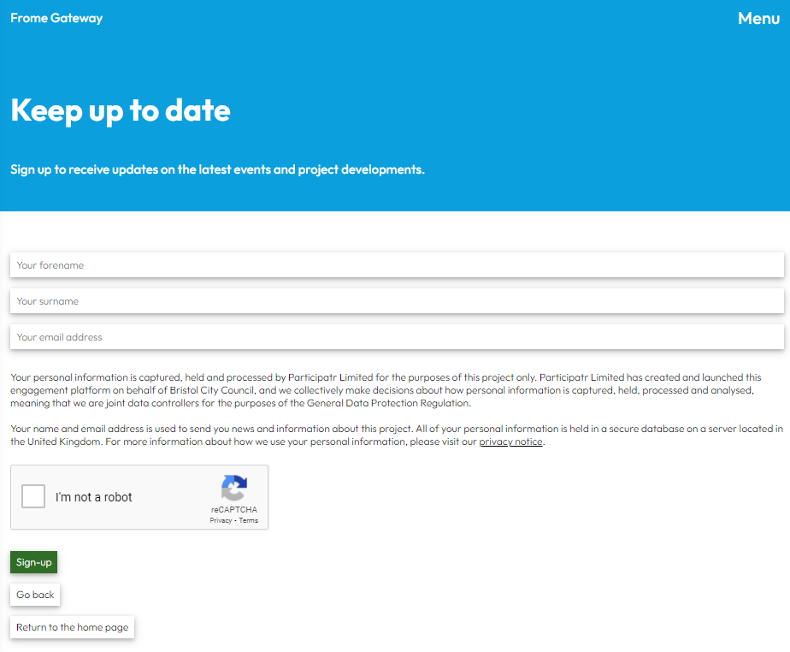
How to stay informed and involved
Sign up to our project mailing list (www.FromeGateway.co.uk) Complete business survey
Complete landowner / developer survey
Share your thoughts on the online interactive map

Slide 28
Tacking the Root Causes Upstream of Unhealthy Urban Development

Slide 29
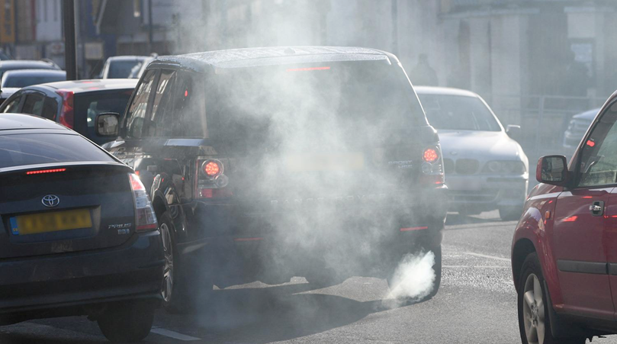
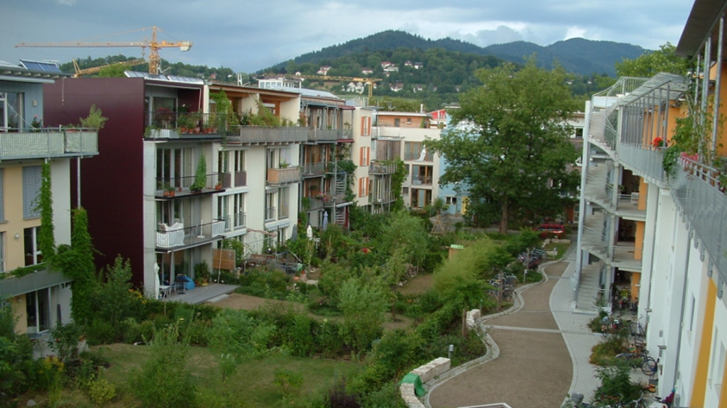
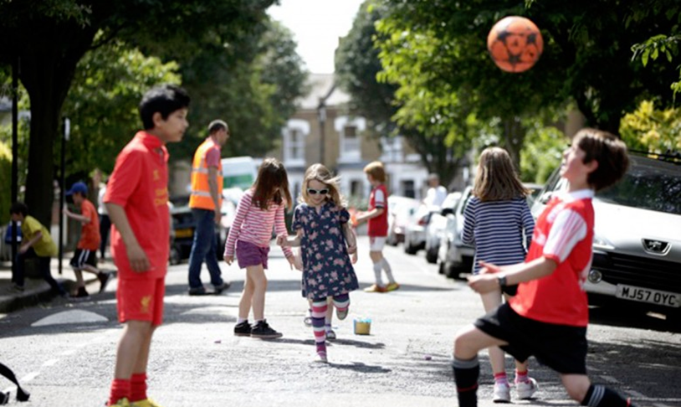
Tackling the Root causes Upstream
of Unhealthy Urban Development
Tackling the
Root causes Upstream of Unhealthy Urban Development
Live Well Make Art

Slide 30
Interactive exercises

Slide 31
Interactive exercises
3 exercises
30 minutes each
90 minutes in total (3.30 - 5.00)
Exercises:
Table 1: Scope of influence
Table2 : Community assets mapping
Table 3: Opportunities and constraints mapping

